Slide 1


Project Id: 23_CS_AIML_2A_03
Project Title:
Sign Language Detection
Welcome to our Sign Language Detection project! In this presentation, we will explore the purpose, features, data analysis, UI design, implementation, and future enhancements of the website.

Slide 2
Team Details
TEAM MEMBERS – Aditya Pratap Singh
Achhansh Gupta
Anupam Kumar Jha
Aanchal Srivastava

Slide 3

Introduction
1
Purpose of the Project
2
Problem Statement
We aim to create a user-friendly platform that helps disable people to communicate with others normally and connect with them freely.
Many people struggle to communicate with others due to their disability. It help them to connect with others easily.

Slide 4
Features of the Website
Search and Filter Options
Personalized Recommendations
User Ratings and Reviews
Easily search and add new words according to your need by entering keywords and showing symbol using camera.
Showing symbols and newly added words according to your search history and interest.
Read and contribute to a community-driven database of ratings and reviews.

Slide 5

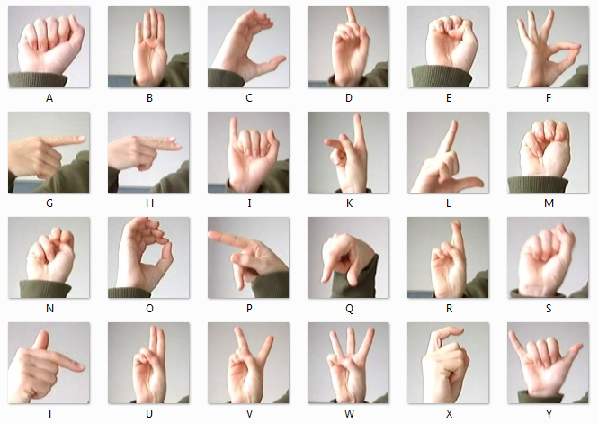
These are some existing symbols for alphabets

Slide 6
Data Collection and Analysis
1
Gathering Symbols Data
Collecting comprehensive information on sign symbols from various sources and APIs.
Cleaning and Processing Data
2
Applying data cleaning techniques to ensure accurate and consistent symbols.
3
Building Recommendation Algorithms
Implementing advanced algorithms to analyze user preferences and make personalized symbols recommendations according to your need.

Slide 7

Way to say “HELLO” in sign language

Slide 8
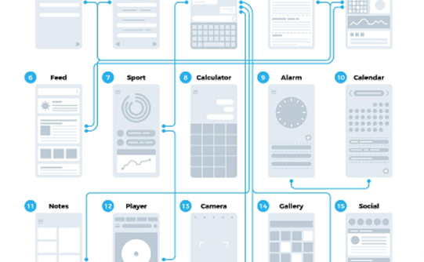
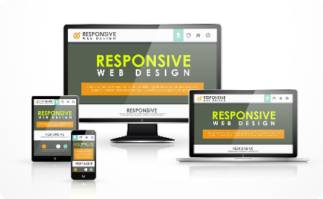
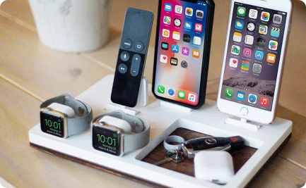
User Interface Design
User-Friendly Layout
Intuitive Navigation
Responsive Design for Multiple Devices
Creating an intuitive and visually appealing layout that makes it easy to navigate and discover symbols.
Designing a seamless navigation system that allows users to explore and find symbols effortlessly.
Ensuring the website looks and functions well on various devices, from desktop to mobile.

Slide 9

Way of asking for HELP in sign language

Slide 10
Implementation and Testing
Backend Development
Frontend Development
Testing and Bug Fixing
Building a robust and scalable backend infrastructure to handle user requests and data management.
Creating a dynamic and interactive user interface using modern web technologies.
Thoroughly testing the website to identify and fix any issues or bugs for a seamless user experience.

Slide 11
Future Enhancements
1
Expanding Database and Symbols Collection
Continuously adding new symbols and enriching the database to provide a diverse selection for users.
Adding Social Features
2
Incorporating social media integration and features like user profiles, followers, and symbols discussions.
3
Incorporating Machine Learning Algorithms
Utilizing machine learning to improve the accuracy of symbols recommendations based on user search.

Slide 12
Conclusion
1
Summary of the Project
2
Potential Impact of the Website
3
Next Steps and Future Plans
We have explored the various aspects of our sign language detection website project, from its purpose to implementation.
By making symbols discovery easier, we aim to enhance users’ connectivity experiences and expand their social life.
We are excited to launch the website and continue iterating on it based on user feedback and emerging technologies.

Slide 13
THANK YOU

